Slide 1

AIRLINES DATA ANALYSIS
-

Slide 2


PROBLEM STATEMENT
To analyze airline passenger feedback data to identify the key factors affecting customer satisfaction, and to provide actionable insights for improving service quality, operational efficiency, and customer loyalty.

Slide 3
Airline industry is highly competitive, with customer satisfaction being a key differentiator.
Large volumes of passenger feedback are collected but not fully utilized for actionable insights.
Lack of clarity on which factors most influence satisfaction and loyalty.
Service improvement efforts risk being reactive and poorly targeted.
Inefficient use of resources leads to gaps in service quality and operational performance.
Missed opportunities to strengthen customer relationships and brand loyalt

Slide 4
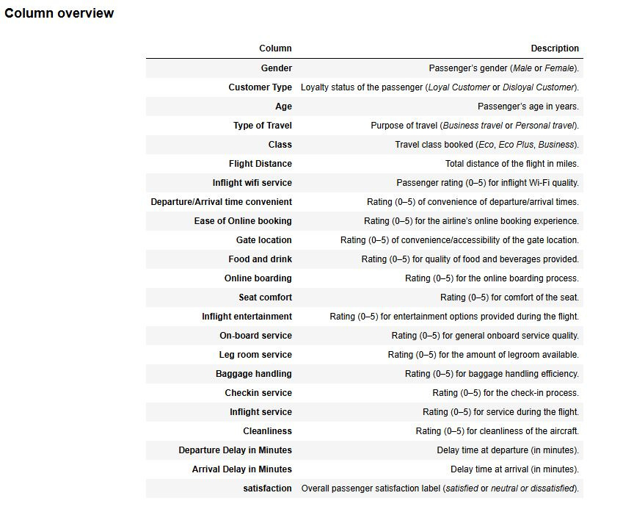
Column overview

Slide 5
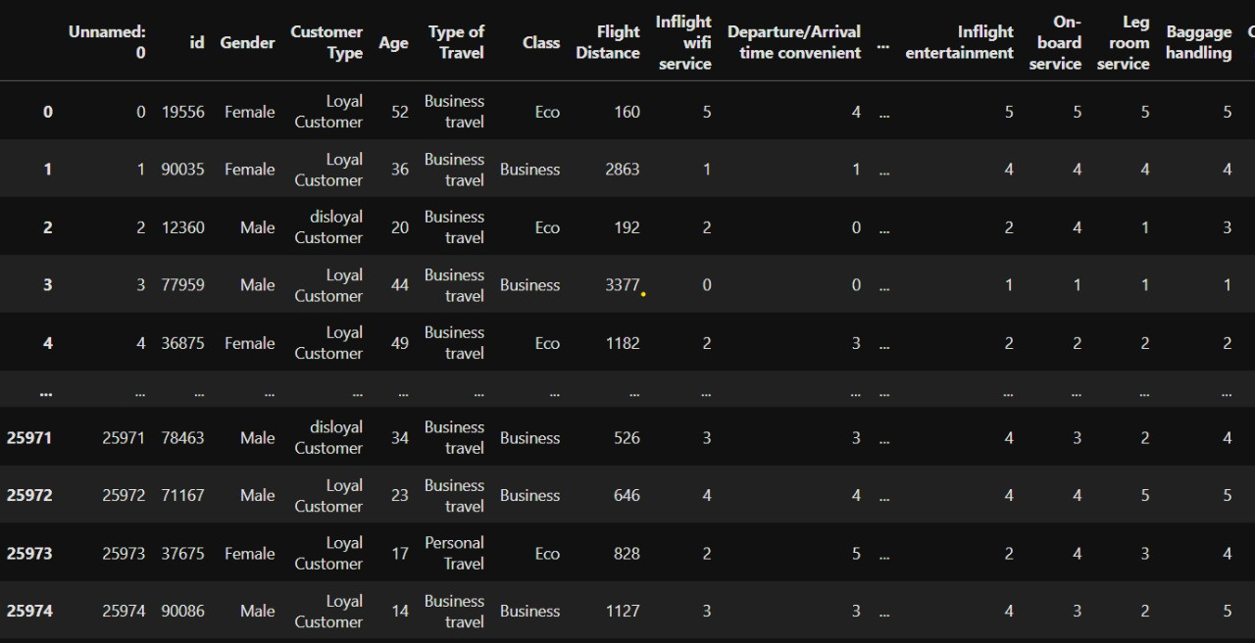

Slide 6

DROPPING THE UNNECESSARY COLUMNS

Slide 7
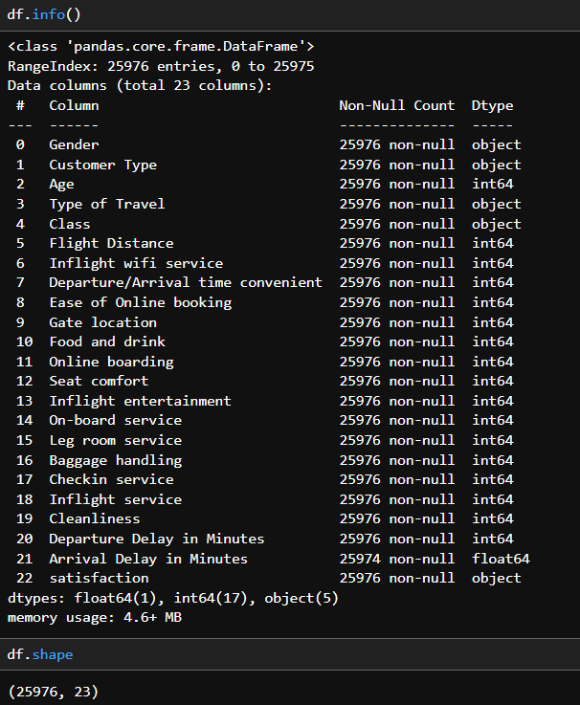
DESCRIPTION OF COLUMNS

Slide 8
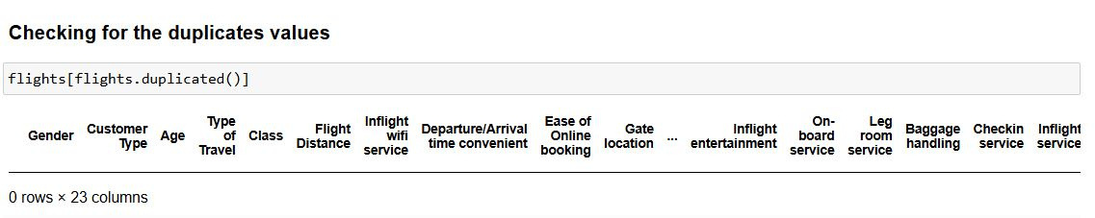
DUPLICATED VALUES

Slide 9
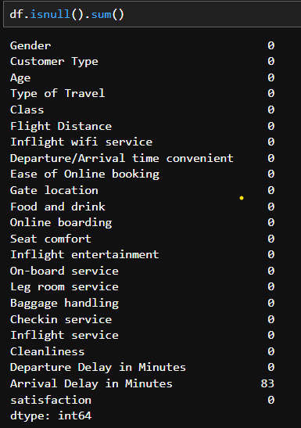
NULL VALUES

Slide 10

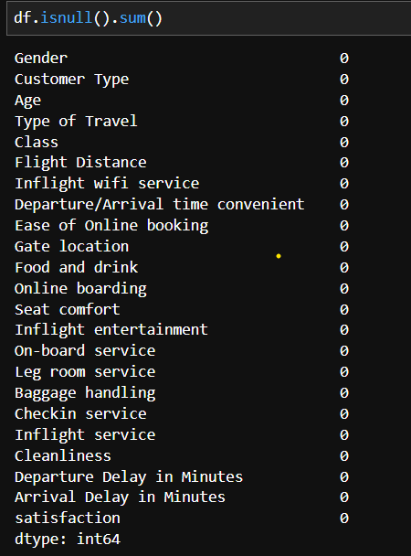
Eliminating null values

Slide 11


BUSINESS PROBLEMS
1• What percentage of satisfied passengers are male vs. female?
2• How does satisfaction differ between Loyal Customer and disloyal Customer groups?
3.Age group vs. satisfaction.
4• Catogorising according to the age (slabs).
5.Age group vs. satisfaction.
6• Across all service rating columns, which service has the highest average rating from passengers?
7. Type of Travel satisfaction comparison.
8• How does Departure Delay in Minutes affect average satisfaction?
9• Compare satisfaction between passengers who experienced an arrival delay vs. those who didn’t?

Slide 12

BUSINESS PROBLEMS
10. Compare satisfaction rates between Business travel and Personal travel passengers.
11. Which travel class (Business, Eco, Eco Plus) has the highest proportion of satisfied passengers?
12. Which onboard service feature (e.g., Inflight wifi service, Seat comfort, Inflight? entertainment) shows the strongest relationship with satisfaction?
13. Do longer flights (above the median distance) have higher or lower satisfaction rates compared to shorter flights?
14. Top 5 longest flight routes and satisfaction.
15. The relationship between Food & drinks to satisfaction.
16. The relationship between cleanliness to satisfaction.
17. "Identifying Key Factors Influencing Customer Satisfaction in Airline Service Data".

Slide 13
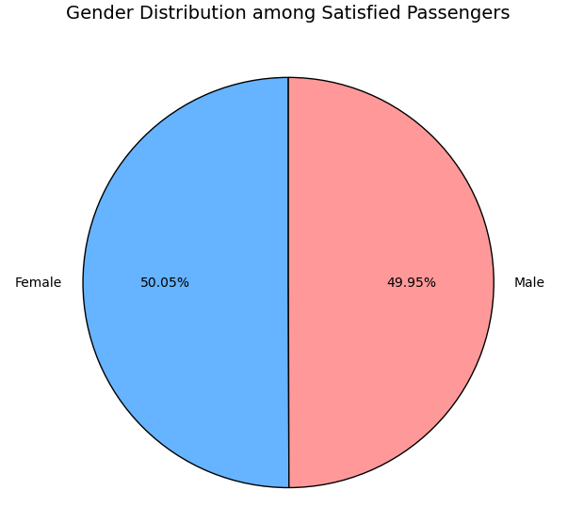
What percentage of satisfied passengers are male vs. female.

Slide 14
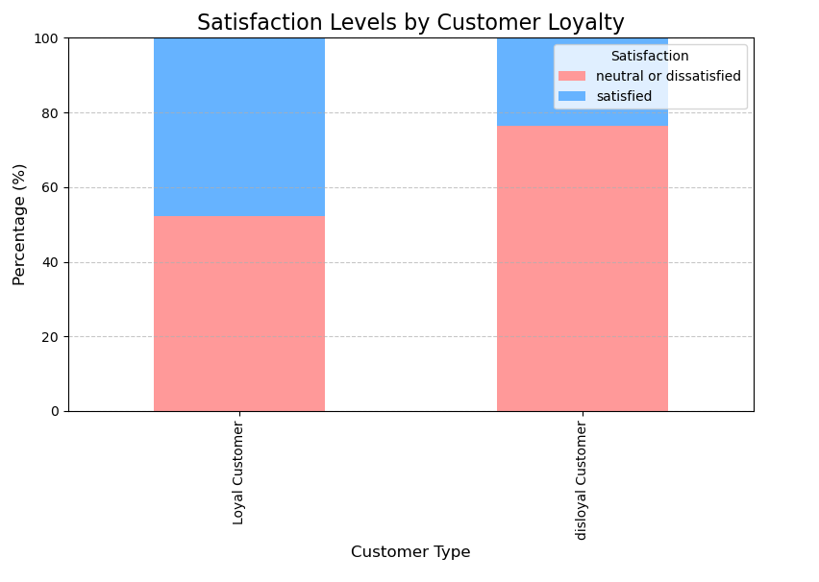
How does satisfaction differ between Loyal Customer and disloyal Customer groups.

Slide 15
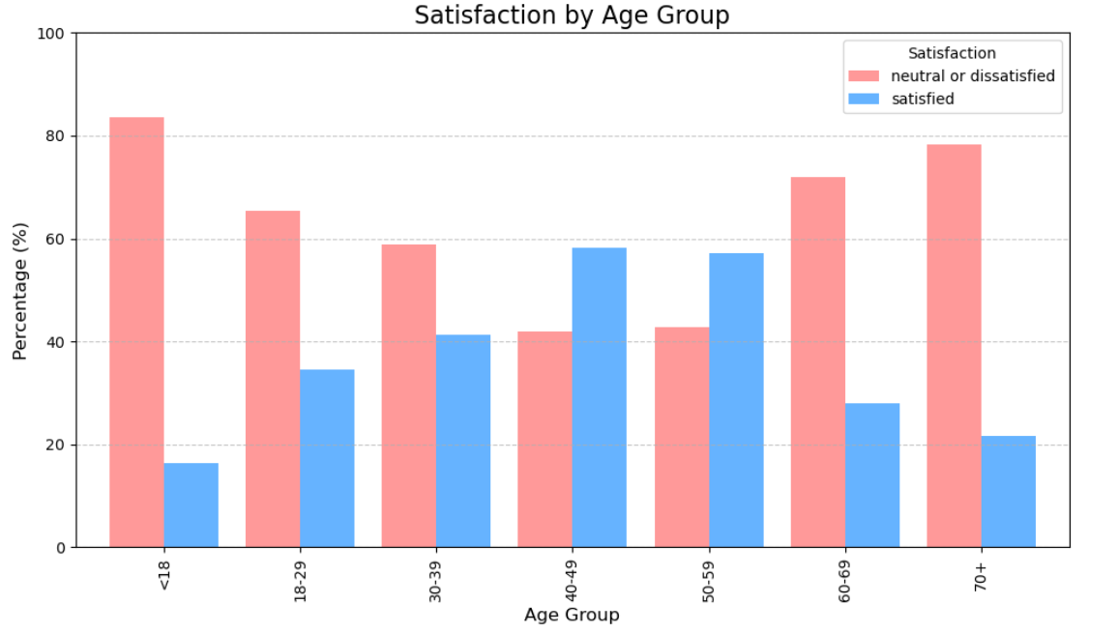
Age group vs. satisfaction.

Slide 16

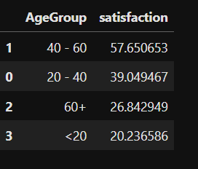

Age group vs. satisfaction.
Highest Satisfaction Rate

Slide 17
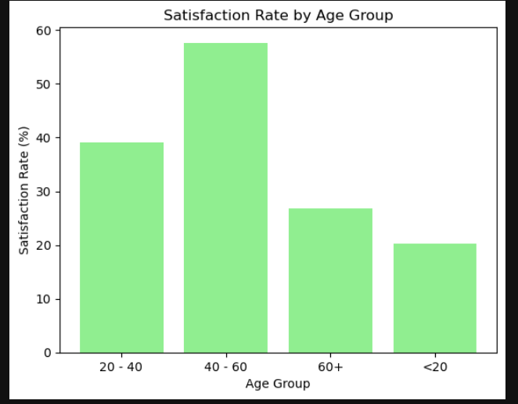
40-60 Years → More travel experience → better understanding of airline services and realistic expectations.
<20 years → more likely to travel economy, may expect more
entertainment or comfort.
60+ years → physical comfort needs not fully met, mobility issues, longer boarding times.

Slide 18
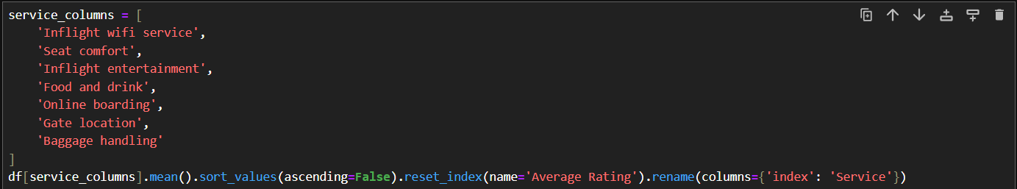
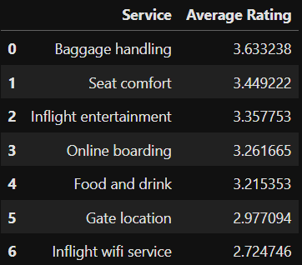
Across all service rating columns, which service has the highest average rating from passengers.
We looked at all the service ratings given by passengers — things like seat comfort, food and drink, baggage handling, etc.
Then, we calculated the average rating for each service to see which one passengers liked the most.

Slide 19
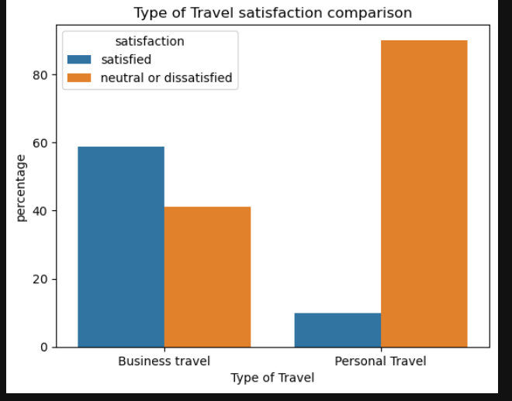
Type of Travel satisfaction comparison.
Business travelers show higher satisfaction rates compared to personal travelers.
Personal travelers have more dissatisfaction, suggesting possible gaps in service experience.
Dissatisfaction among personal travelers might stem from:
Service expectations not being met
Comfort-related issues (e.g., seating, in-flight amenities)

Slide 20
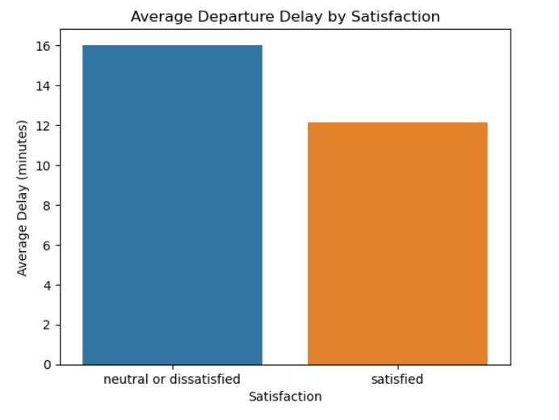
How does Departure Delay in Minutes affect average satisfaction.
On average, satisfied passengers had a departure delay of 12.12 minutes, while neutral or dissatisfied passengers had a longer delay of 16.02 minutes. This suggests longer departure delays tend to be linked with lower satisfaction

Slide 21
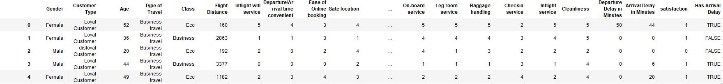
Compare satisfaction between passengers who experienced an arrival delay vs. those who didn’t?

Slide 22
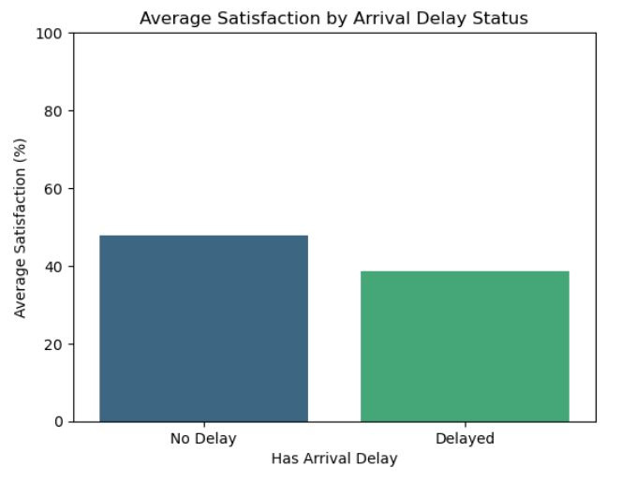
Passengers without an arrival delay were 47.90% satisfied, while those with a delay were only 38.69% satisfied.
Satisfaction drops by about 9 percentage points when an arrival delay occurs.

Slide 23
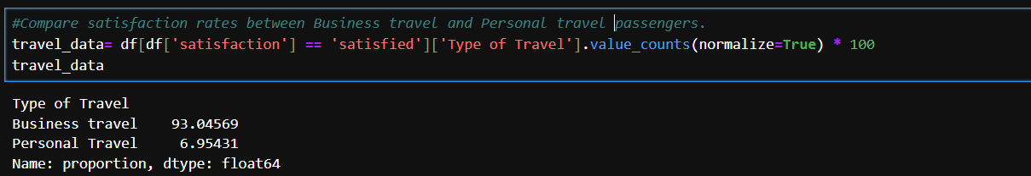
Compare satisfaction rates between Business travel and Personal travel passengers.

Slide 24
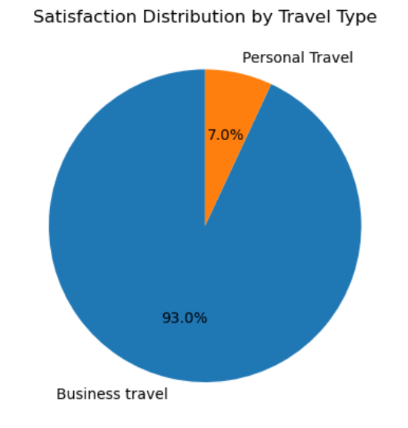

Slide 25

Which travel class (Business, Eco, Eco Plus) has the highest proportion of satisfied passengers?

Slide 26
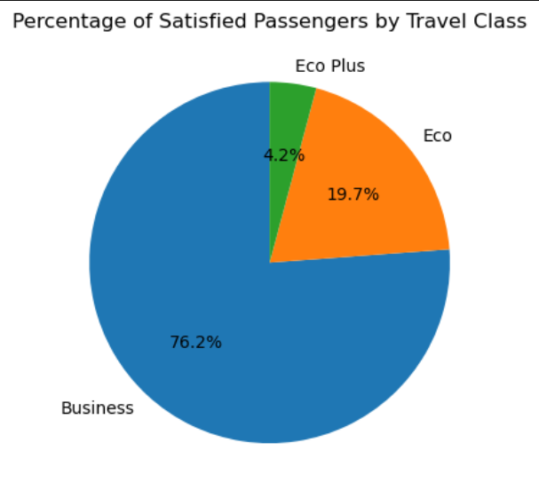

Slide 27
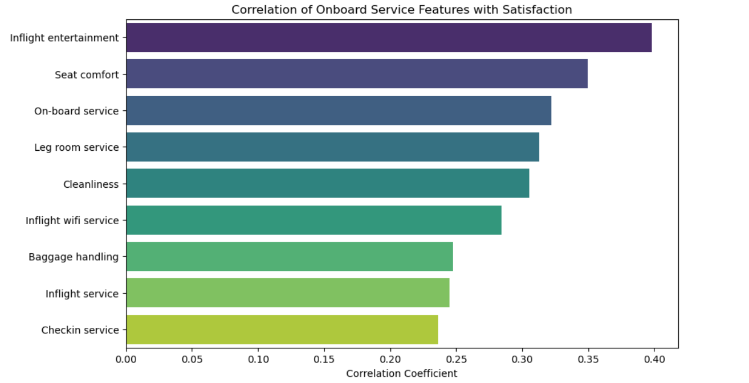
Which onboard service feature shows the strongest relationship with satisfaction?

Slide 28
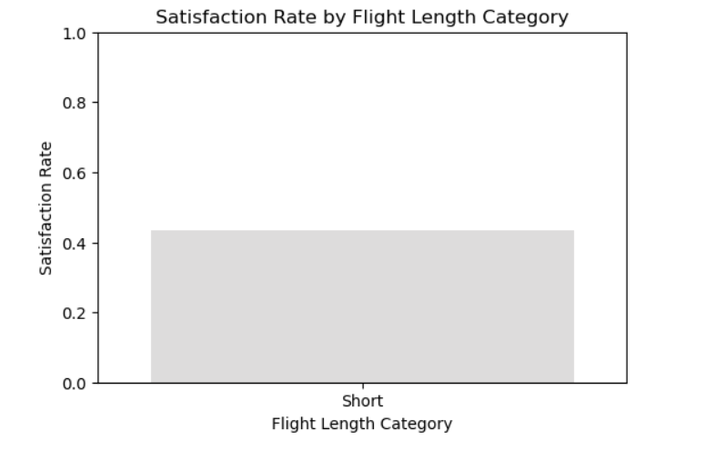
Do longer flights have higher or lower satisfaction rates compared to shorter flights

Slide 29
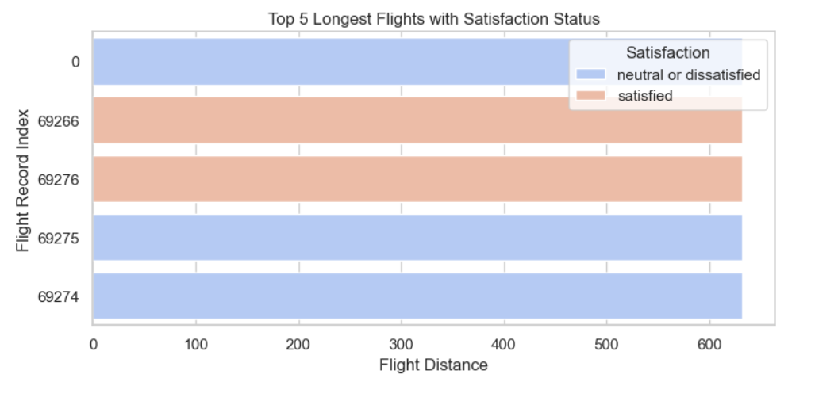
Top 5 longest flight routes and satisfaction

Slide 30

The relationship between Food & drinks to satisfaction
1 LAKH 3THOUSAND 9 0 4

Slide 31
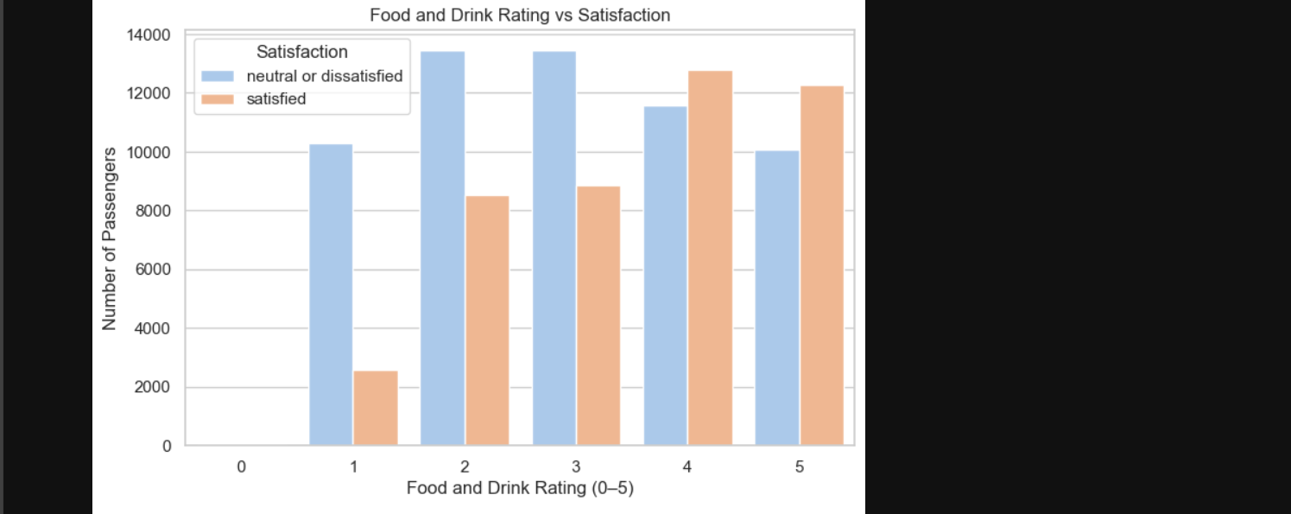
The relationship between Food & drinks to satisfaction

Slide 32

The relationship between cleanliness to satisfaction

Slide 33
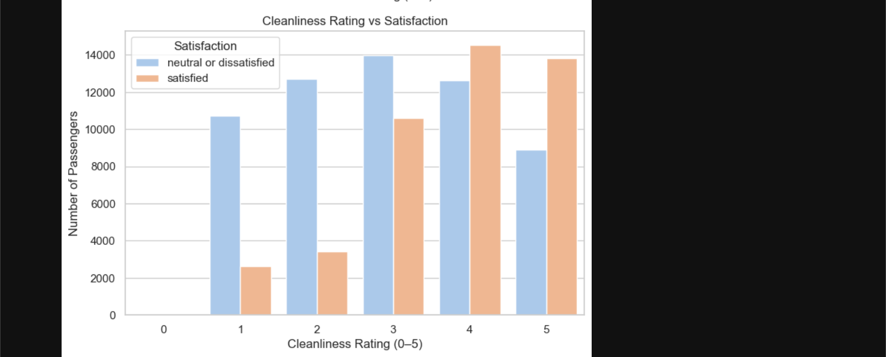
The relationship between cleanliness to satisfaction

Slide 34
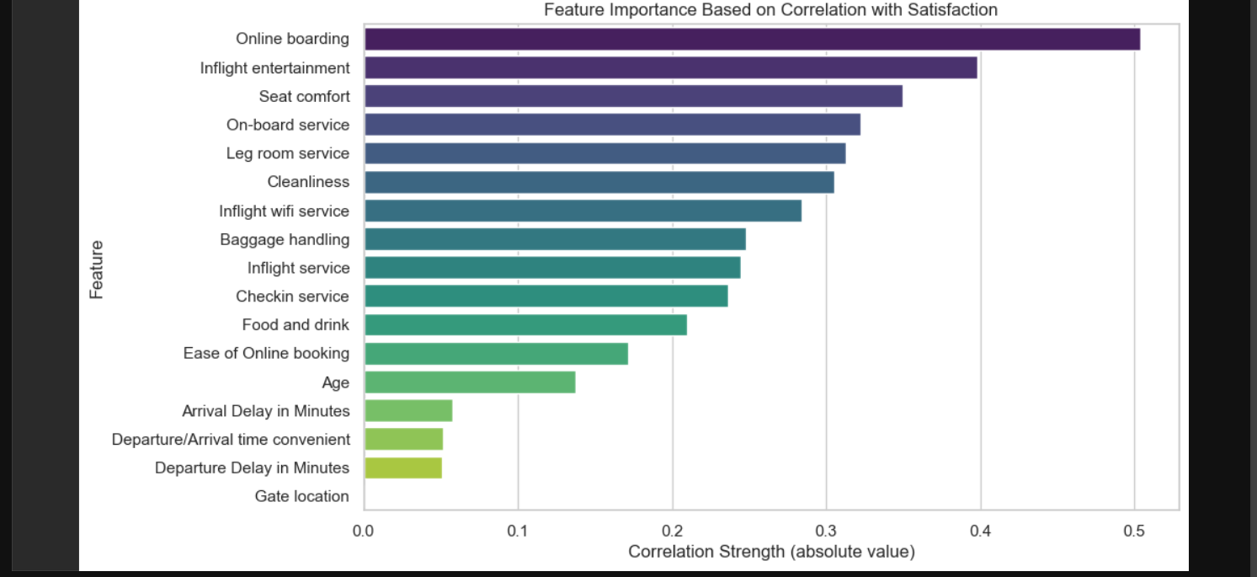
"Identifying Key Factors Influencing Customer Satisfaction in Airline Service Data"

Slide 35
Conclusion
The analysis reveals that passenger satisfaction is most strongly influenced by service-related factors, particularly online boarding, inflight entertainment, and seat comfort. These features show the highest correlation values (0.36–0.50), indicating a substantial impact on overall satisfaction. In contrast, operational aspects such as gate location and flight delays have very weak correlations (<0.10), suggesting they play a minimal role in shaping customer perceptions. Focusing improvement efforts on the top-ranked service elements is likely to yield the greatest gains in satisfaction scores.

